Slide 1
Pathways Compliance Advisor 16.0
Running ABN’s

Slide 2
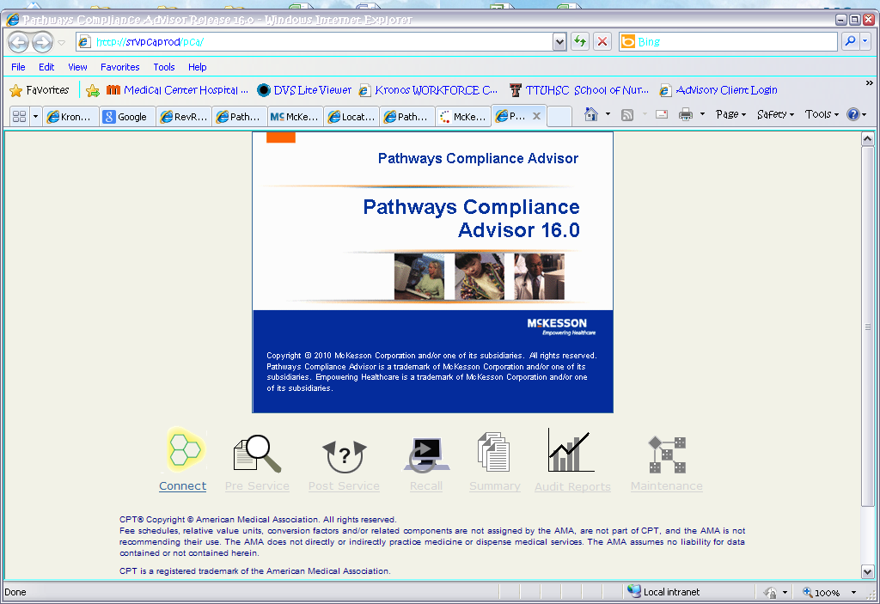
Main Screen
#1 - Press Connect
#2 - Press Pre-Service

Slide 3
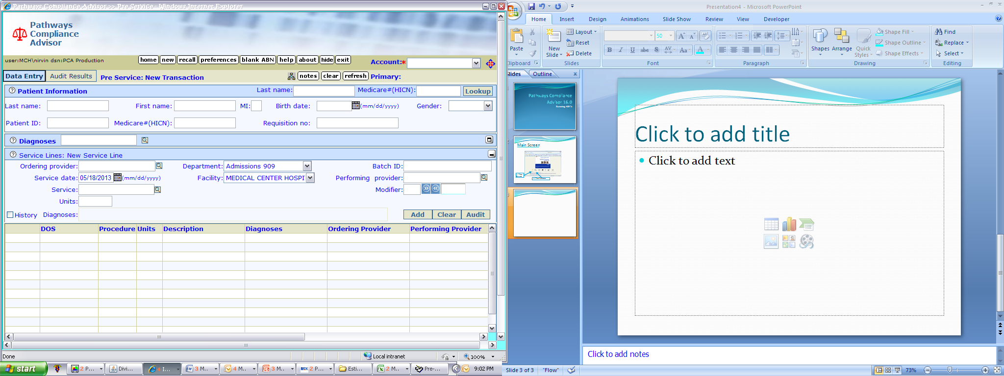
1st Screen – Data Screen
Make sure you expand each section
You must select our account with Novitas here
Input the following
  Last Name
  First Name
  Middle Initial
  Birth Date
  Gender
  Patient ID (acct #)
  Medicare #
  Skip Requisition #

Slide 4
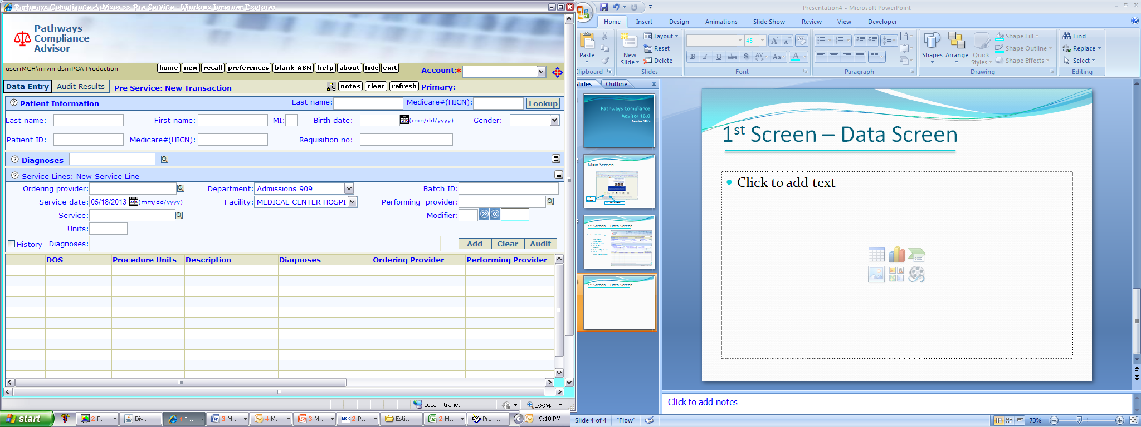
1st Screen – Data Screen
Diagnosis Entry
  Input the diagnosis from the order
  Be the detective!
  Use Google for ICD codes if needed
  Multiple diagnosis will appear in a pop up screen
  Select the one that best fits the diagnosis on the order by double clicking on the “CODE”
  Then press OK
  If there are multiple diagnosis, enter each one

Slide 5
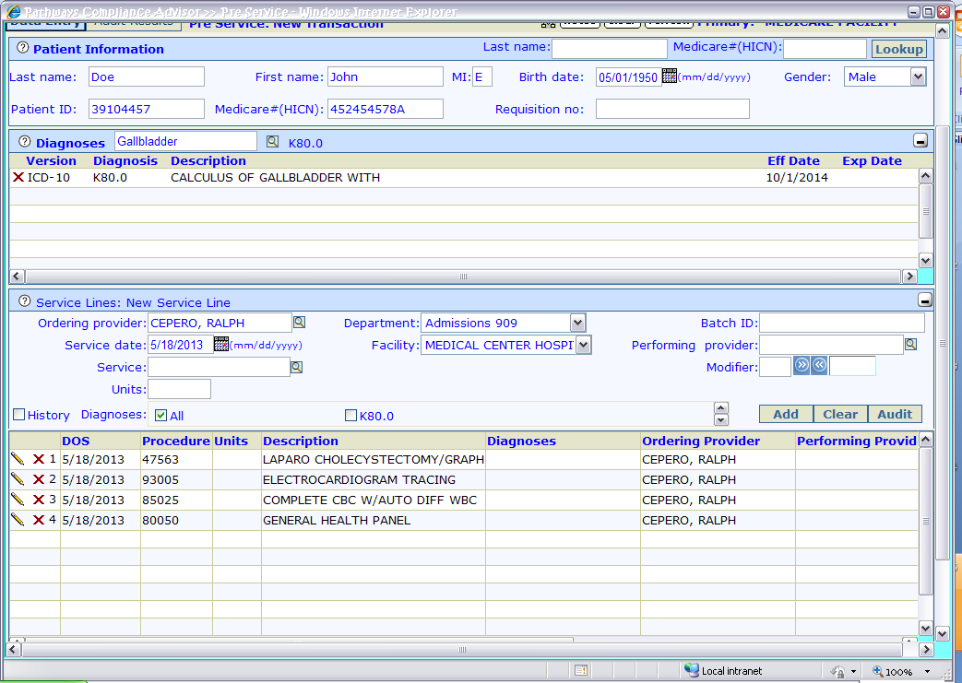
1st Screen – Data Screen
Service Line Input
Input Ordering Physician
Department should already be on “Admissions 909”
Input each service
Call the coders if you are having difficulty finding the code. Look under web outlook for HIM coders for the group numbers
Once all procedures are done press “Audit”
If a procedure is not covered, it will let you know.
You will need to input a CNE note stating the ABN number and whether it is valid or invalid
If it is invalid, also place an F10 alert

