Slide 1

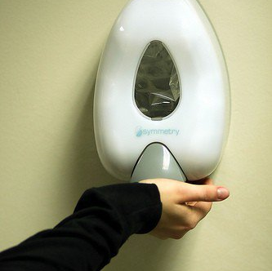
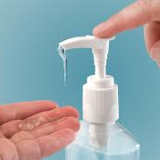
Infection Prevention
How I learned to be more conscientious and love the gel.

Slide 2

What do we do?
Monitor Hand Hygiene compliance
Monitor equipment cleaning
Provide education to staff and visitors: Orientation, in service, newsletter, display case, blog, social media, classes
Provide a resource for staff
ID Surveillance: CLABSI, CAUTI, SSI, VAP, MDRO
Collect and report data to the local health departments, TxDHS and Nat’l Healthcare Safety Network (NHSN)
Work with engineering on ICRA’s, temperature/humidity monitoring, airflow
Provide education to outpatients/community

Slide 3
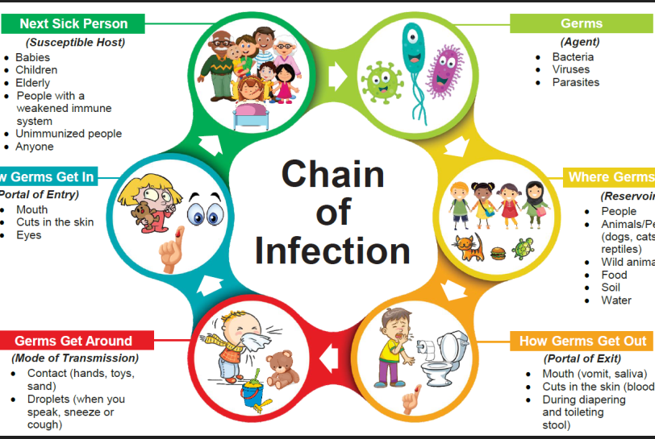
The primary goal of infection prevention/control is to prevent the transmission of infectious diseases
Notes:
Break the chain of infection

Slide 4

Infectious Disease Examples
Common Cold
Influenza
Severe Acute Respiratory Syndrome (SARS)
Meningitis
Chickenpox
C-difficille (C-diff)
Tuberculosis (TB)
Hepatitis A, B, and C
Staph/Methicillin-resistant Staphylococcus aureus (MRSA)
Vancomycin Resistant Enterococcus (VRE)

Slide 5
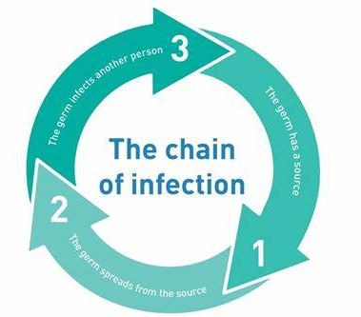
How Are Infectious Diseases Spread?
Understanding how infectious diseases are spread is important to minimizing the risk of infection and preventing disease transmission.
Three ways in which infectious diseases can be transmitted:
Direct transmission
Indirect transmission
Airborne transmission

Slide 6
Direct Transmission
Direct transmission occurs when an infectious agent is transferred directly into the body such as through the eyes, nose, mouth, or through a break in the skin such as a cut on the finger. Infectious agents are spread directly in the following ways:
Person-to-person
- through physical contact including touching, biting, hugging, or kissing
- Example: MRSA, Hepatitis
Animal-to-person
- through physical contact, bites, and scratches
- Example: Ringworm, Rabies
Infectious droplets
- during coughing, sneezing, talking, singing, and spitting (spread is limited to approximately three feet)
- Example: Cold, Influenza

Slide 7
Indirect Transmission
Infectious diseases are spread indirectly through vehicles and vectors.
Vehicle-borne transmission
  Some infectious agents can linger on inanimate objects, such as desks, chairs, computer, keyboards, doorknobs, faucets, toys, eating utensils, or clothing.
  Example: Touching a pencil used by a person infected with the flu and then touch your the eyes, nose, or mouth before performing hand hygiene.
Vector-borne transmission
  Common vectors include insects, such as mosquitoes, ticks, and lice
  Example: Becoming infected with West Nile Virus as a results of being bitten by an infected mosquito, or sharing a comb with someone who had head lice.

Slide 8
Airborne Transmission
Airborne transmission is the spread of infectious agents as aerosols that usually enter the respiratory tract. These tiny particles have the ability to remain suspended in the air for long periods of time and travel long distances.
Tuberculosis, chicken pox, and the measles are examples of infectious diseases spread by airborne particles.

Slide 9


Slide 10

What tools does MCHS provide to keep you safe?
Engineering Controls: Sharps Containers, Negative pressure rooms, Air flow
Personal Protective Equipment
Hand wash stations
Proper cleaning products
Educational Opportunities
Influenza and Hep B vaccinations free to all employees.

Slide 11
Seasonal influenza “The Flu”
It is caused by influenza viruses, which target respiratory areas such as the nose, throat, and lungs.
People with flu can spread it to others up to about 6 feet away via droplets made when someone with flu coughs, sneezes or talks
A person can also get flu by touching a surface or object that has flu virus on it and then touching their own mouth, nose, or eyes
People with flu are most contagious in the first 3-4 days after their illness begin.
However, some people may be able to infect others beginning 1 day before symptoms develop and up to 5 to 7 days after becoming sick.
Centers for Disease Control and Prevention, National Center for Immunization and Respiratory Diseases (NCIRD). (2018)
Notes:
Most experts think that flu viruses spread mainly by droplets made when people with flu cough, sneeze or talk. These droplets can land in the mouths or noses of people who are nearby or possibly be inhaled into the lungs.

Slide 12
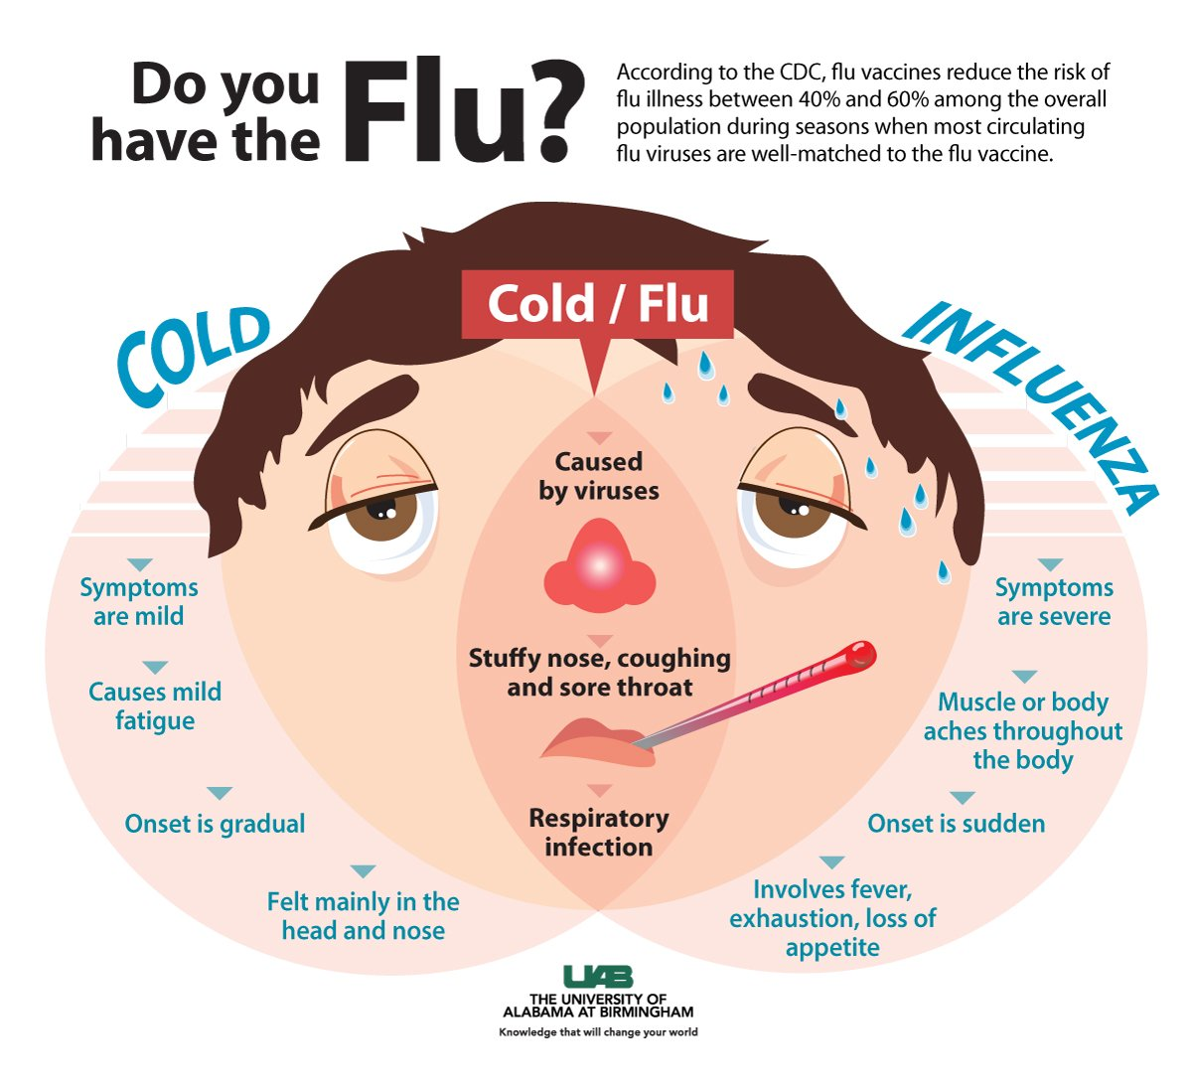

Slide 13
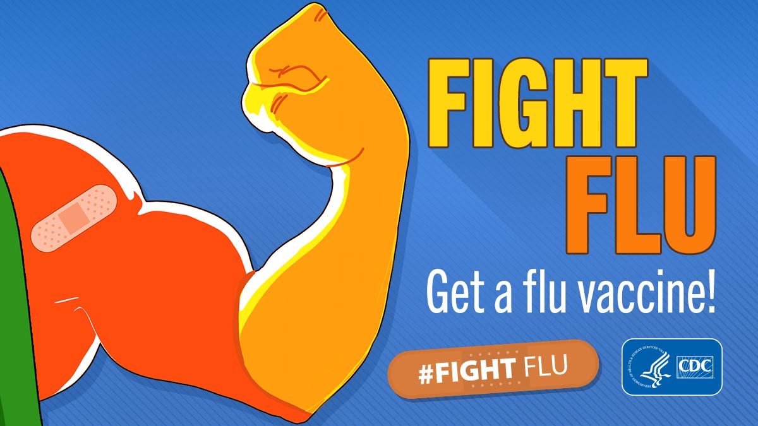
Preventing seasonal flu
The first and most important step in preventing flu is to get a flu vaccine each year.
It is not too late to get your flu vaccine!
  Centers for Disease Control and Prevention, National Center for Immunization and Respiratory Diseases (NCIRD). (2018)
Notes:
Flu vaccine has been shown to reduce flu related illnesses and the risk of serious flu complications that can result in hospitalization or even death.
Seasonal flu vaccination is recommended for everyone 6 months of age and older unless they have a specific contraindication to flu vaccine.
Recent studies by CDC researchers and other researchers suggest that flu vaccination usually reduces the risk of influenza illness by 40% to 60% among the overall population when the vaccine viruses are like the ones spreading in the community.

Slide 14
Preventing the Spread of Cold/Flu
CDC recommends everyday preventive actions such as:
  Staying away from people who are sick
  Covering coughs and sneezes
  Frequent handwashing
  Keep their hands away from their nose, mouth and eyes.
  Routinely clean surfaces and objects that are touched often, such as desks, countertops, doorknobs, computer keyboards, hands-on learning items, faucet handles, phones, keys, & elevator buttons.
  Centers for Disease Control and Prevention, National Center for Immunization and Respiratory Diseases (NCIRD). (2018)
Notes:
Teach students and staff to cover coughs and sneezes with a tissue or their bent arm. If they use a tissue, they should put the used tissue in a trash can and wash their hands.
Provide adequate supplies within easy reach, including tissues and no-touch trash cans.

Slide 15
Personal Protective Equipment or PPE
Consists of gloves, gowns, masks, eye protection, shoe protection
Use is based on type of precaution:
  Standard (Universal) precautions – the belief that every patient, every situation is potentially hazardous.
    Hand Hygiene
    Gloves
  Transmission based precautions – choosing the correct PPE according to the mode in which a disease is spread.
    Hand Hygiene
    Gloves
    Proper PPE for transmission
Isolation precaution signs instruct your behavior for isolation rooms
  Placed on door of isolation patient rooms
  Isolation carts with PPE will be outside room

Slide 16
Examples of contact isolation appropriate patients:
MDRO’s such as MRSA and VRE
Draining wounds
Scabies, Lice, Bed bugs

Slide 17
Examples of Droplet isolation appropriate patients:
Seasonal Flu
Bacterial Meningitis
Strep Throat
Pertussis/RSV

Slide 18
Examples of Airborne/Respiratory precaution appropriate patients:
Tuberculosis (TB)
Shingles/Chicken Pox (dessiminated)
Measles
Avian Flu

Slide 19
Examples of Special Enteric precaution appropriate patients:
Clostridium dificile (C.diff)
Norovirus
Acute Diarrhea

Slide 20

What things should you do to keep yourself, your patients and your co-workers safe?
Wash…Your…Hands
Clean your equipment
Ask colleagues to wash their hands
Educate patients/patient families about hand washing and isolation precautions
Get vaccinated annually!
Wash…Your…Hands

Slide 21

Hand Hygiene
Your hands are NASTY! Think of everything you touch in a single day!
Some things we can see: Blood, feces, other matter.
Some things we can’t see: bacteria, viruses, spores.
Hand washing is your first line of defense for your safety AND your patient’s.
Remember: If it’s wet, slimy and not yours, don’t touch it.

Slide 22

When Should You Wash Your Hands
Before and after glove use
When hands appear soiled
After blowing the nose, sneezing, or coughing
After using the restroom.
Before and After touching eyes, nose, or mouth
Before preparing medications
Before preparing, serving, or handling food
Before eating lunch or snacks
Frequently when sick or after contact with others who are sick
Before and after touching a cut or wound

Slide 23
Hand Washing
Components of proper hand washing include:
- Soap
- Clean water
- Hand gel/sanitizer
- Friction (F-R-O-G: Friction rubs out germs)

Slide 24
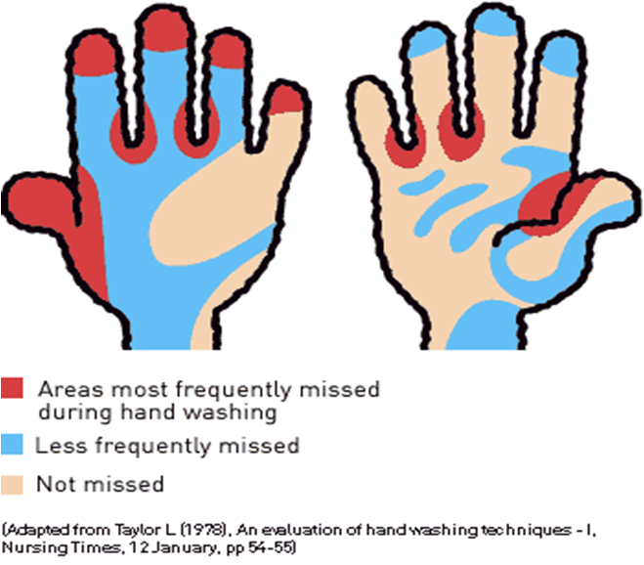
Frequently Missed Areas

Slide 25
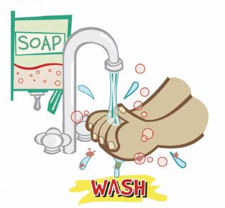
Ways to prevent spreading infection
Wash
Wash hands frequently using soap and water for 15-20 seconds.
Substitute
Substitute alcohol-based hand sanitizer when clean water and soap are unavailable.
Promote
Promote appropriate respiratory etiquette: Cover coughs and sneezes with tissue. Throw away tissues immediately and WASH YOUR HANDS. If a tissue is not available, sneeze or cough into the elbow or upper sleeve.
Remain
Remain at home when ill and encourage others to do the same.
Avoid
Avoid close contact (less than 3 feet of space) with those who are sick
Maintain and promote
Maintain and promote good personal hygiene; bathe and wash hands regularly
Discourage
Discourage touching the eyes, nose, and mouth.
Maintain
Maintain a clean working environment.
Ensure
Ensure commonly used areas such as door handles, eating surfaces, and desks are clean and disinfected.

Slide 26

Keep open or draining wounds clean and covered with a bandage.
Avoid contact with other people’s wounds or bandages.
Discourage sharing eating utensils, glassware, or personal items such as combs, razors, towels, clothing or other items that come into contact with bare skin.
Clean shared equipment before and after each use.
Avoid skin-to-skin contact with anyone who has an open wound or skin infection.
Encourage a healthy lifestyle that includes a nutritious diet and adequate sleep.

